Slide 1
Information Retrieval
Topic- XML Retrieval
Lecture-32
Prepared By
Dr. Rasmita Rautray & Dr. Rasmita Dash
Associate Professor
Dept. of CSE

Slide 2
XML Retrieval

Slide 3
Content
XML Retrieval
XML Retrieval : Challenges

Slide 4
IR and relational databases
IR systems are often contrasted with relational databases (RDB).
Traditionally, IR systems retrieve information from unstructured text (“raw” text without markup).
RDB systems are used for querying relational data: sets of records that have values for predefined attributes such as employee number, title and salary.
RDB search unstructured IR
objects records unstructured docs
main data structure table inverted index model relational model vector space & others
queries SQL free text queries
Some structured data sources containing text are best modeled as structured documents rather than relational data ( Structured retrieval).

Slide 5
Structured retrieval
Basic setting: queries are structured or unstructured; documents are structured.
Applications of structured retrieval
Digital libraries, patent databases, blogs, tagged text with entities like persons and locations (named entity tagging).

Slide 6
Why RDB is not suitable in this case
Three main problems :
An unranked system (DB) would return a potentially large number of articles that mention the Vatican, the Coliseum and sightseeing tours without ranking them by relevance to the query.
Difficult for users to precisely state structural constraints -
may not know which structured elements are supported by the system.
tours AND(COUNTRY : Vatican OR
LANDMARK : Coliseum) ?
tours AND (STATE :Vatican OR BUILDING : Coliseum) ?
Users may be completely unfamiliar with structured search and advanced search interfaces or unwilling to use them.
Solution: adapt ranked retrieval to structured documents to address these problems.

Slide 7
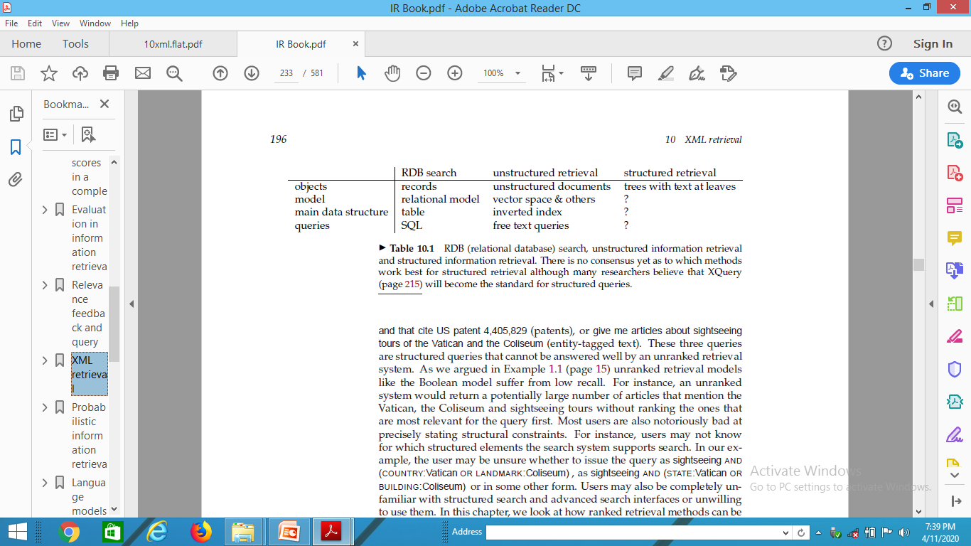
Structured Retrieval
Standard for encoding structured documents: Extensible Markup Language ( XML)
structured IR → XML IR
also applicable to other types of markup (HTML, SGML, ...)

Slide 8
XML document
Ordered, labeled tree
Each node of the tree is an XML element, written with an opening and closing XML tag (e.g.
<title...>, </title...>)
An element can have one or more XML attributes (e.g. number)
Attributes can have values (e.g. vii)
Attributes can have child elements (e.g. title, verse)
<play>
<author>Shakespeare</author>
<title>Macbeth</title>
<act number=” I”>
<scene number=” vii”>
<title>Macbeth’s castle</title>
<verse>Will I with wine
...
</verse>
</scene>
</act>
</play>

Slide 9
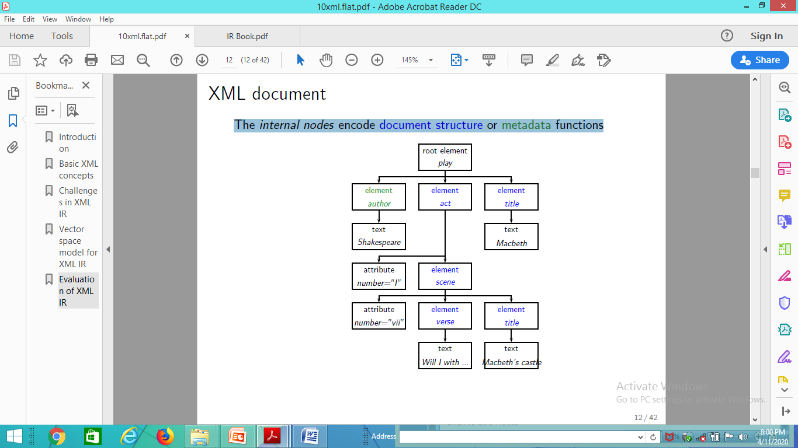
XML document
The internal nodes encode document structure or metadata functions

Slide 10
XML basics
XML Document Object Model (XML DOM): standard for accessing and processing XML documents
The DOM represents elements, attributes and text within elements as nodes in a tree.
With a DOM API, we can process an XML document by starting at the root element and then descending down the tree from parents to children.
XPath: standard for enumerating paths in an XML document collection.
We will also refer to paths as XML contexts or simply contexts
Schema: puts constraints on the structure of allowable XML documents. E.g. a schema for Shakespeare’s plays: scenes can only occur as children of acts.
Two standards for schemas for XML documents are: XML DTD (document type definition) and XML Schema.

Slide 11
Challenges in XML IR

Slide 12
First challenge: document parts to retrieve
Structured or XML retrieval: users want us to return parts of documents (i.e., XML elements), not entire documents as IR systems usually do in unstructured retrieval.
Example
If we query Shakespeare’s plays for Macbeth’s castle, should we return the scene, the act or the entire play?
In this case, the user is probably looking for the scene.
However, an otherwise unspecified search for Macbeth should return the play of this name, not a subunit.
Solution: structured document retrieval principle

Slide 13
Structured document retrieval principle
Structured document retrieval principle
One criterion for selecting the most appropriate part of a document:
A system should always retrieve the most specific part of a document answering the query.
Motivates a retrieval strategy that returns the smallest unit that contains the information sought, but does not go below this level.
Hard to implement this principle algorithmically. E.g. query: title: Macbeth can match both the title of the tragedy, Macbeth, and the title of Act I, Scene vii, Macbeth’s castle.
But in this case, the title of the tragedy (higher node) is preferred.
Difficult to decide which level of the tree satisfies the query.

Slide 14
Second challenge: document parts to index
Central notion for indexing and ranking in IR: document unit or indexing unit.
In unstructured retrieval, usually straightforward: files on your desktop, email messages, web pages on the web etc.
In structured retrieval, there are four main different approaches to defining the indexing unit.
non-overlapping pseudodocuments
top down
bottom up
all

Slide 15
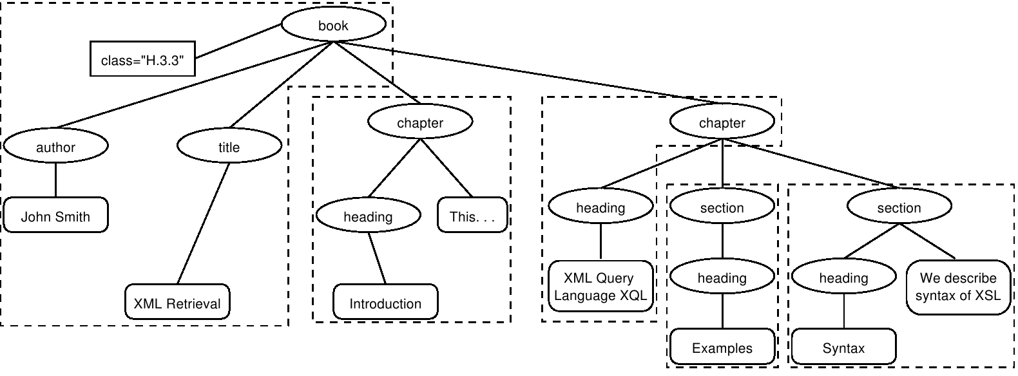
XML indexing unit: approach 1
Group nodes into non-overlapping pseudo-documents.
Indexing units: books, chapters, sections, but without overlap.
Disadvantage: pseudo-documents may not make sense to the user because they are not coherent units.

Slide 16
XML indexing unit: approach 2
Top down (2-stage process):
start with one of the largest elements as the indexing unit,
e.g. the book element in a collection of books
then, post process search results to find for each book the sub-element that is the best hit.
This two-stage retrieval process often fails to return the best sub-element because the relevance of a whole book is often not a good predictor of the relevance of small sub-elements within it.

Slide 17
XML indexing unit: approach 3
Bottom up:
Instead of retrieving large units and identifying sub-elements (top down), we can search all leaves, select the most relevant ones and then extend them to larger units in post processing.
Similar problem as top down: the relevance of a leaf element is often not a good predictor of the relevance of elements it is contained in.

Slide 18
XML indexing unit: approach 4
Index all elements: the least restrictive approach. Also problematic:
many XML elements are not meaningful search results, e.g., an ISBN number.
indexing all elements means that search results will be highly redundant.
Example
For the query Macbeth’s castle we would return all of the play, act, scene and title elements on the path between the root node and Macbeth’s castle. The leaf node would then occur 4 times in the result set: 1 directly and 3 as part of other elements.
We call elements that are contained within each other nested elements. Returning redundant nested elements in a list of returned hits is not very user-friendly.

Slide 19
Third challenge: nested elements
Because of the redundancy caused by nested elements it is common to restrict the set of elements eligible for retrieval. Restriction strategies include:
discard all small elements
discard all element types that users do not look at (working XML retrieval system logs)
discard all element types that assessors generally do not judge to be relevant (if relevance assessments are available)
only keep element types that a system designer or librarian has deemed to be useful search results
In most of these approaches, result sets will still contain nested elements.

Slide 20
Third challenge: nested elements
Further techniques:
remove nested elements in a post processing step to reduce redundancy.
collapse several nested elements in the results list and use highlighting of query terms to draw the user’s attention to the relevant passages.
Highlighting
Gain 1: enables users to scan medium-sized elements (e.g., a section); thus, if the section and the paragraph both occur in the results list, it is sufficient to show the section.
Gain 2: paragraphs are presented in-context (i.e., their embedding section). This context may be helpful in interpreting the paragraph.

Slide 21
Nested elements and term statistics
Further challenge related to nesting: we may need to distinguish different contexts of a term when we compute term statistics for ranking, in particular inverse document frequency (idf).
Example
The term Gates under the node author is unrelated to an occurrence under a content node like section if used to refer to the plural of gate. It makes little sense to compute a single document frequency for Gates in this example.
Solution: compute idf for XML-context term pairs.
sparse data problems (many XML-context pairs occur too rarely to reliably estimate df)
compromise: consider the parent node x of the term and not the rest of the path from the root to x to distinguish contexts.

Slide 22
Thank You

